Slide 1
Happiness on Tap: Piped Water Adoption in Urban Morocco
By Florencia Devoto, Esther Duflo, Pascaline Dupas, William Parienté, and Vincent Pons
American Economic Journal: Economic Policy 2012, 4(4): 68–99

Slide 2
Table of Conents
Introduction
Data & Policy Issue
Context of the evaluation
Findings
Details of the intervention
Relevance to Pakistan
1
2
3
4
01
1

Slide 3
1
Introduction

Slide 4
Introduction
Most interventions to connect poor households to the drinking water network are primarily concerned with physical health.
Researchers conducted a randomized evaluation to look at the effect of private connections in a setting where most households already had access to high-quality water through public taps.
Morocco had a high willingness to pay for piped water.
Notes:
Most interventions to connect poor households to the drinking water network are primarily concerned with physical health, but improved water access may have other important effects on household well-being by reducing the amount of time spent fetching water. Researchers conducted a randomized evaluation to look at the effect of private connections in a setting where most households already had access to high-quality water through public taps. They found that households in Tangiers, Morocco had a high willingness to pay for piped water, and while home water connection had no impact on waterborne illness, households' self-reported happiness improved substantially.

Slide 5
2
Data & Policy Issue

Slide 6
Data & Policy Issue
The sample included 845 households residing on 732 plots.
Three surveys were conducts to gather data:
Baseline Household Survey
Incidence of Illness
Endline Household Survey
Access to water is a critical factor in household welfare.
Limited water supply affects the lives of the poor in many ways beyond health.
Fetching water is time-and-labor-intensive.
Source of tension within and among households.
Notes:
Access to water is a critical factor in household welfare, in large part because of the well-established health benefits of a reliable, clean water supply. But it is difficult, in most settings, to separate the effects of clean water from the effects of increased quantity and convenience. A limited water supply affects the lives of the poor in many ways beyond health. Fetching water is time-and-labor-intensive, which could detract from education or productive activities, a burden which is thought to fall disproportionately on women and children. When a family’s water supply is limited or contested, it can be a source of tension within and among households. And inconvenient access to water may contribute to stress or unhappiness.

Slide 7
3
Context of the evaluation

Slide 8
Context of the evaluation
Households that rely on public taps spent more than seven hours a week collecting water.
65 percent of households without a water connection reported that water was a major source of concern: 16 percent had a water-related conflict within the family, and 12 percent had a conflict with their neighbors.
Thus, both within the family and between families, water was an important source of stress and tension.
Notes:
In urban Morocco, the setting of this study, households that rely on public taps spent more than seven hours a week collecting water, despite a relatively high density of water taps. In this sample, 65 percent of households without a water connection reported that water was a major source of concern: 16 percent had a water-related conflict within the family, and 12 percent had a conflict with their neighbors. Thus, both within the family and between families, water was an important source of stress and tension

Slide 9
4
Details of the intervention

Slide 10
Details of the intervention
Amendis launched a social program
Identified three zones to work in
Chance to buy a connection to the water and sanitation network on interest-free credit
Offered loan program depending on the zone’s distance from the water grid
Notes:
In 2007, Amendis, a local affiliate a private international utility company, launched a social program that offered low-income households in Tangier, Morocco a chance to get an in-home connection to the city water system
Identified three zones to work in and surveyed households within those areas to find those that HH that were not connected to the city water system
Almost 60% of unconnected households relied on public taps for their water & 40% of households not getting their water from the public taps were using a neighbor’s connection
Amendis offered low-income households in the three zones a chance to buy a connection to the water and sanitation network at full price, but on interest-free credit
Depending on the zone’s distance from the water grid, households in that zone were offered a three, five, or seven-year loan that would be paid off at MAD 105 (US$15) per month with their monthly water bill

Slide 11
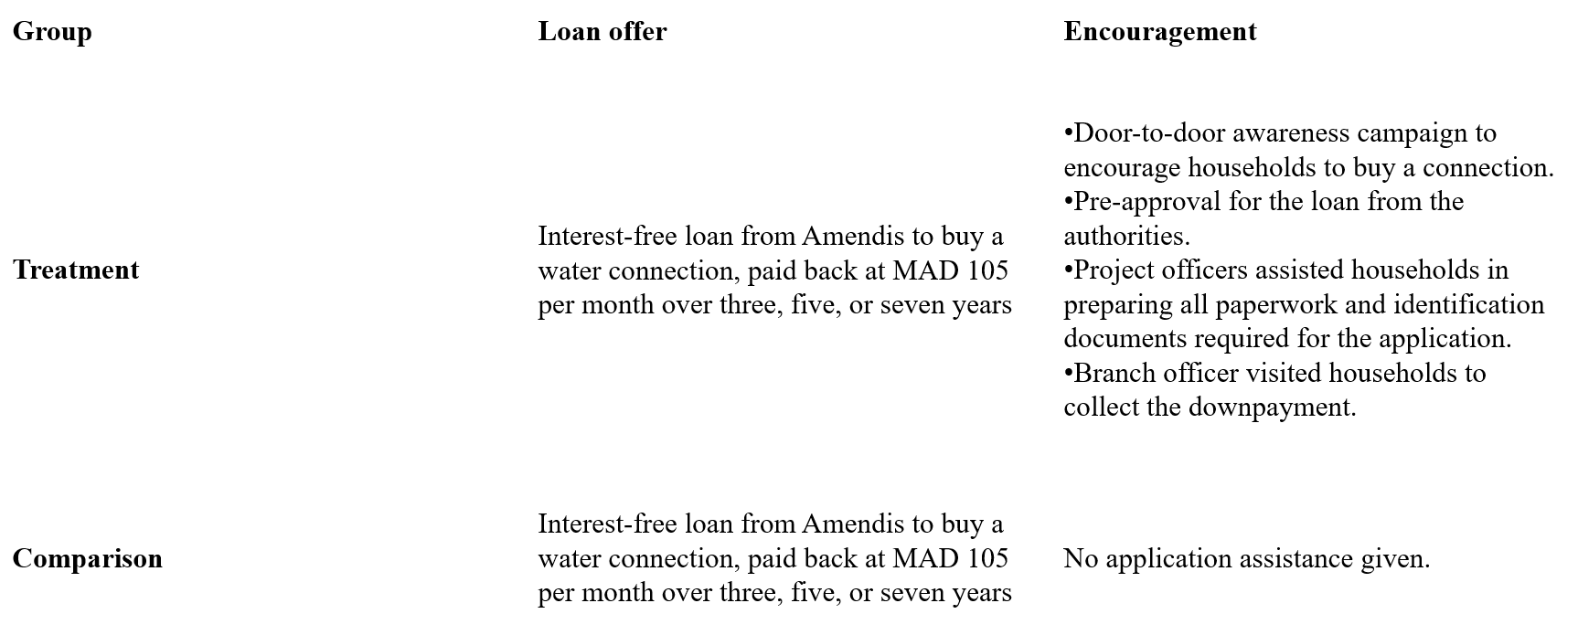
Details of the intervention

Slide 12
Details of the intervention
Researchers used a randomized encouragement design
Surveyed in 2007 and again in 2008
Information collected on several variables
Tested for levels of chlorine and the presence of E. coli.
Tracked “illness diary” and school participation of children under 15 years old
Notes:
Since both the treatment and comparison groups were eligible for the loan program, the researchers used a randomized encouragement design to evaluate the impact of the program
Households were surveyed in 2007, before the start of the program, and again in 2008, five months after the water connections were installed in treatment households that enrolled
Information was collected on household socioeconomic characteristics, health, hygiene practices, water collection, work and work-related conditions, time use, and social networks
In a random subset of households, the water was tested for levels of chlorine and the presence of E. coli.
Households with children under 15 years old were asked to fill out a month-long “illness diary” to track instances of fever, vomiting, or diarrhea and children’s school participation was also tracked with surveys

Slide 13
Details of the intervention
Informed about the program
Find out whether comparison-group houses had subsequently applied for a connection
Notes:
In January 2009, all comparison-group houses were informed about the program, including information on the various procedures required to apply for it, as part of a survey debrief
Administrative data on in-home water connection applications was obtained in August of 2009 to find out whether comparison-group houses had subsequently applied for a connection

Slide 14
5
Findings

Slide 15
Regression Equation
Y = quality, quantity of water consumed, water-related time and financial costs incurred by the household, child health, time use and social integration
Treat = Treat is a dummy equal to 1 if the household has received the encouragement
X = is a vector of household characteristics
Randomized assignment of Treat ensures that E(εi1 | Xi ,Treati ) = 0

Slide 16
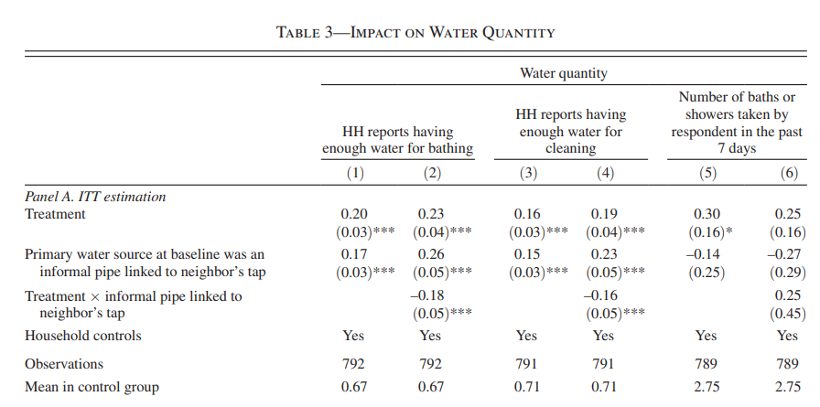
Key Takeaways from Regression Estimates
Impact on water quantity:
Connecting houses to the water grid increased the quantity of water families consumed.
Households in the treatment group were 20 percentage points report having enough water for bathing
16 percentage points more likely to report having enough water for cleaning. CP

Slide 17
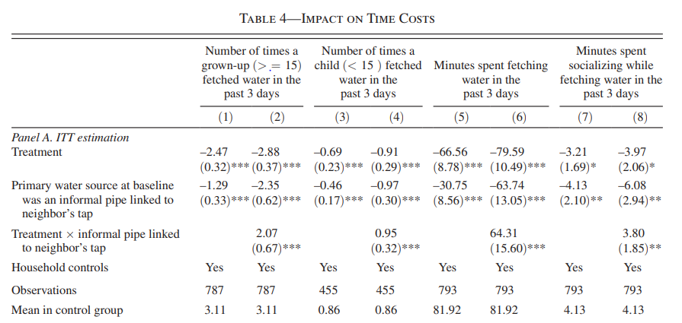
Impact on Time Costs
connection considerably reduced the number of water fetching trips in the treatment group
reduced from 82 minutes on average in the control group to zero
This effect is entirely concentrated among those who did not have running water
CP

Slide 18
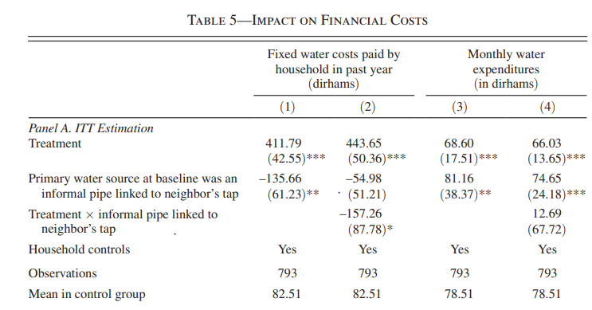
Impact on Financial Costs
households had to pay a relatively large fixed cost to get connected
pay both their monthly water bill and their monthly installment
Monthly Bill: 78 to around 147 Moroccan dirhams
CP

Slide 19
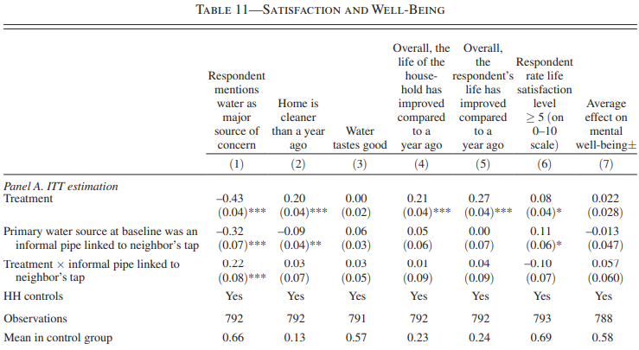
Findings
66 percent of control households mentioned water when prompted to list their 5 major sources of concerns, only 28 percent of treatment households did so, Ceteris Paribus.
Eighteen months after the awareness campaign and eight months after a study debrief explaining the program, 33 percent of households with at least one treatment house within 20 meters had a connection, compared with only 15 percent among households with no treatment houses nearby, Ceteris Paribus.

Slide 20
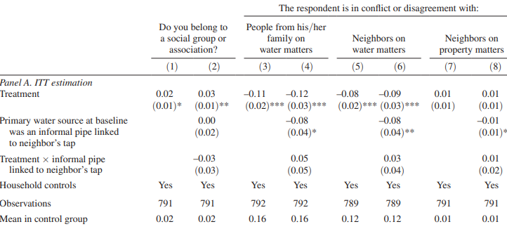
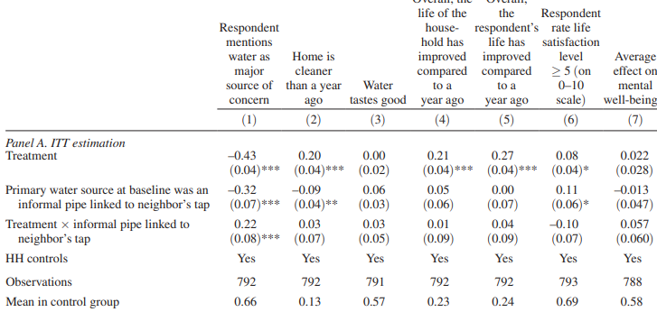
Findings
In the comparison group, 16 percent of households were having conflict with family members over water-related issues, while 12 percent were in disagreement with neighbors, and there are negative tensions in treatment, Ceteris Paribus.
23 percent of respondents in the control group report that the life of their household has improved compared to a year ago, this rises by 21 percent, Ceteris Paribus.

Slide 21
6
Relevance to Pakistan

Slide 22
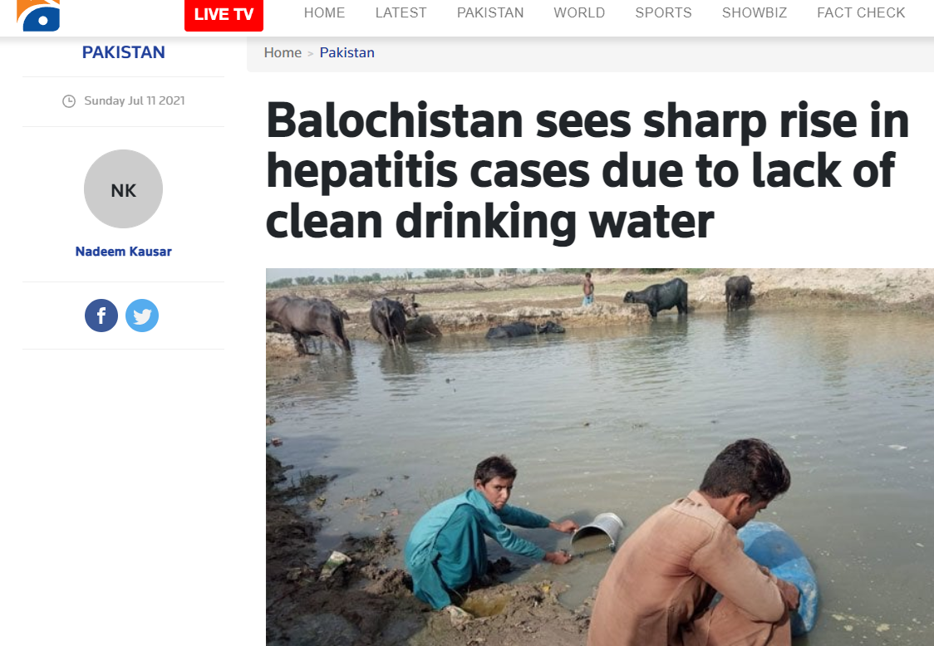
Relevance
A finding that may not be significant: Heath Issues
Providing public facilities at credit and installment basis might be a way out
Balochistan. Sindh and South Punjab can benefit if they are provided clean water resource

Slide 23
Thank You!

